Slide 1
Assessing female genitalia, anus, and rectum
Weber Chapter 27
NURS3120: Health assessment and promotion

Slide 2
Objectives
Describe the structure and function of the female genitalia, anus, and rectum.
Discuss risk factors associated with cervical cancer and ways to reduce one’s risks.
Differentiate between normal and abnormal findings of female genitalia, anus, and rectum.

Slide 3
Structure and Function: A&P
External Genitalia
Internal Genitalia
Vulva or pudendum
Mons Pubis
Labia majora
Labia minora
Urethral meatus
Vagina
Cervix
Uterus
Fallopian tubes
Ovaries
Notes:
Vulva or Pudendum: extends from the mons pubis to the anal opening
Mons pubis: is the fat pad located over the symphysis pubis. In the normal adult the mons pubis is covered with pubic hair in a triangular pattern. Its function is to absorb force and to protect the symphysis pubis during coitus.
Labia majora: are two folds of skin that extend posteriorly and inferiorly from the mons pubis to the perineum. The outer most surface of the labia majora is covered with pubic hair and the inner surface is pink, smooth, and moist
Labia minora: are folds of thinner skin inside of the labia majora. these folds join anteriorly at the clitoris and form a prepuce or hood; posteriorly the two folds join to form the frenulum. It contains numerous sebaceous glands that promote lubrication and maintain the moist environment in the vaginal area.
Urethral Meatus: opening to the bladder
Vagina: orifice from the external opening to the cervix
Cervix: neck of the uterus; separates the upper end of the vagina from the isthmus of the uterus
Uterus: pear-shaped muscular organ that has two components: the corpus or body and the cervix or the neck. The uterus is positioned above the bladder at a 45degree angle when standing.
Ovaries: are a pair of small oval shaped organs each of which is situated on a lateral aspect of the pelvic cavity. the function is to develop and release ova and to produce hormones such as estrogen, progesterone, and testosterone.
Fallopian Tubes: the ovum travels from the ovary to the uterus through the fallopian tubes.

Slide 4
Collecting subjective data: OBGYN history
Menstrual history
Obstetric history
  Gravida: # of pregnancies
  Para: # of births >20 weeks gestation
  Abortions: # of “interrupted” pregnancies
    Can be spontaneous or induced
Menopause
  Cessation of menses
    Perimenopausal: 40-55 years
    Hormone replacement therapy (HRT)
      Side effects: Fluid retention, breast pain, breast cancer, vaginal bleeding, endometrial cancer
Notes:
Menstrual history: Date of your last menstrual period? Are they regular? How long to they last? Any clotting? Normal: Cycle usually occurs approx. every 18 to 45 days. Average length is 3 to 7 days. Absence of menstruation, excessive bleeding, or a marked change in menstrual pattern needs to collect more information. Any other symptoms do you experience before or during your period (cramps, bloating, moodiness, breast tenderness) Headache, weight gain, mood swings, abdominal cramping, and bloating are common complaints before or during the menstrual period. Some women experience premenstrual syndrome (PMS) in which the symptoms become severe enough to impair the woman’s ability to function. How old were you when you started your period? Menarche tends to begin earlier in women living in developed countries and later in women who live in undeveloped countries.
Menopause: Absence of menses for 12 months is a normal physiologic process that occurs in women between the ages of 40 to 58 years with a mean age of 50. During perimenopausal period, hormone levels may fluctuate, resulting in menstrual irregularities. Periods may be heavier or may become scant.
HRT: It is important to discuss and explain the risk versus benefits of HRT with the client. Estrogen has been linked to some types of cancer (breast and endometrial), and it increases the glycogen content in vaginal secretions, predisposing clients to yeast infections.
Just be mindful of the client’s feelings about menopause, some welcome it with open arms and others can experience grief

Slide 5
Collecting subjective data: GYN
Any vaginal discharge, pain, or itching?
Lumps, swelling, or masses?
Sexual performance issues?
When was your last pelvic exam?
Smoke?
How many sexual partners have you had?
Contraception?
What is your sexual preference?
Notes:
Vaginal discharge may be normal or from an infection, complaints of pain in the area of the vulva, vagina, uterus and cervix or ovaries may indicate infection, itching may indicate infection or infestation
Lumps/Masses/Swelling: may indicate infection, lymphedema, or cancer
Sexual performance: some women have difficulty achieving an orgasm and may believe that there is something wrong with them.
Sexual activity: Any pain in the vulva, vagina, uterus, cervix, or ovaries may indicate infection. Problems in sexual activity or libido needs to be investigated for cause.
Cervical history: a PAP smear is used to screen for cervical cancer and is recommended that an annual PAP test and pelvic examination should be done at age 21, not before.
Do they smoke? The risk for cervical cancer increases in clients who smoke and who are infected with HPV.
Sexual partners: increases the client's risk for STIs
Oral contraceptives: Failure to use contraceptives increases the risk of becoming pregnant, non using condoms puts a client at risk for STI’s which could affect their cervical history if left untreated.
Side effects: (Minor) weight gain, breast tenderness, headaches, nausea. They also increase the risk of vaginal yeast infections. Oral contraceptives increase the glycogen content of vaginal secretions. Major side effects of oral contraceptives: Stroke, DVT, MI.. What can increase your risk for these major side effects? Smoking, frequent travel job (airplane or car).
Sexual preference: we need to think about other STIs located in the anus and the oral region for transmission and contact

Slide 6
Collecting subjective data: GU
Urinary history
Urgency, dysuria, nocturia, hematuria
Urge incontinence
Involuntary urine loss from overactive detrusor muscles in the bladder
Stress incontinence
Involuntary urine loss with physical strain (sneezing/coughing)
Notes:
Do you have any difficulty urinating? Do you have any burning or pain with urination? Has your urine changed color or developed an odor? Any difficulty controlling your urine? Urinary frequency, burning or pain, are signs of infection (UTI or STI) whereas hesitancy or straining could indicate blockage. Change in color and development of an abnormal odor could indicate infection or renal insufficiency/failure.
Urge incontinence is incontinence related to the inability to hold urine beyond the time of mental awareness of the need to urinate. Clients can use noninvasive bladder training or scheduling to help minimize episodes, along with Kegel exercises. There are medication options as well.
Stress incontinence is from the intra-abdominal pressure and some physical strain, sneezing or coughing releases spontaneous urination. Clients also see success with noninvasive bladder training or scheduling and Kegels. There are surgical options as well.

Slide 7
Collecting subjective data: Bowel
Usual bowel pattern? Any recent changes?
Pain?
Constipation or diarrhea?
Trouble controlling your bowels?
Characteristics of stool?
Pain or itching in the rectal area?
Notes:
A change in bowel pattern is associated with many disorders and is one of the warning signs of cancer. A more thorough evaluation, including laboratory tests, may be necessary.
Constipation may indicate a bowel obstruction or the need for dietary counseling.
Diarrhea may signal impaction or indicate the need for dietary counseling.
Fecal incontinence occurs with neurologic disorders and some gastrointestinal infections.
Stool color: Black stools may indicate gastrointestinal bleeding or the use of iron supplements or bismuth subsalicylate. Red blood in the stool is found with hemorrhoids, polyps, cancer, or colitis. Clay-colored stools result from a lack of bile pigment.
Large amounts of mucus that occur on a regular basis, associated with diarrhea, may be caused by some intestinal infections. Bloody mucus in stool, or mucus with abdominal pain, may be seen in Crohn disease, ulcerative colitis, and even cancer.
STIs, hemorrhoids, pinworms, candida, or anal trauma may cause itching. STI, hemorrhoids, fissure, or trauma may cause pain.

Slide 8
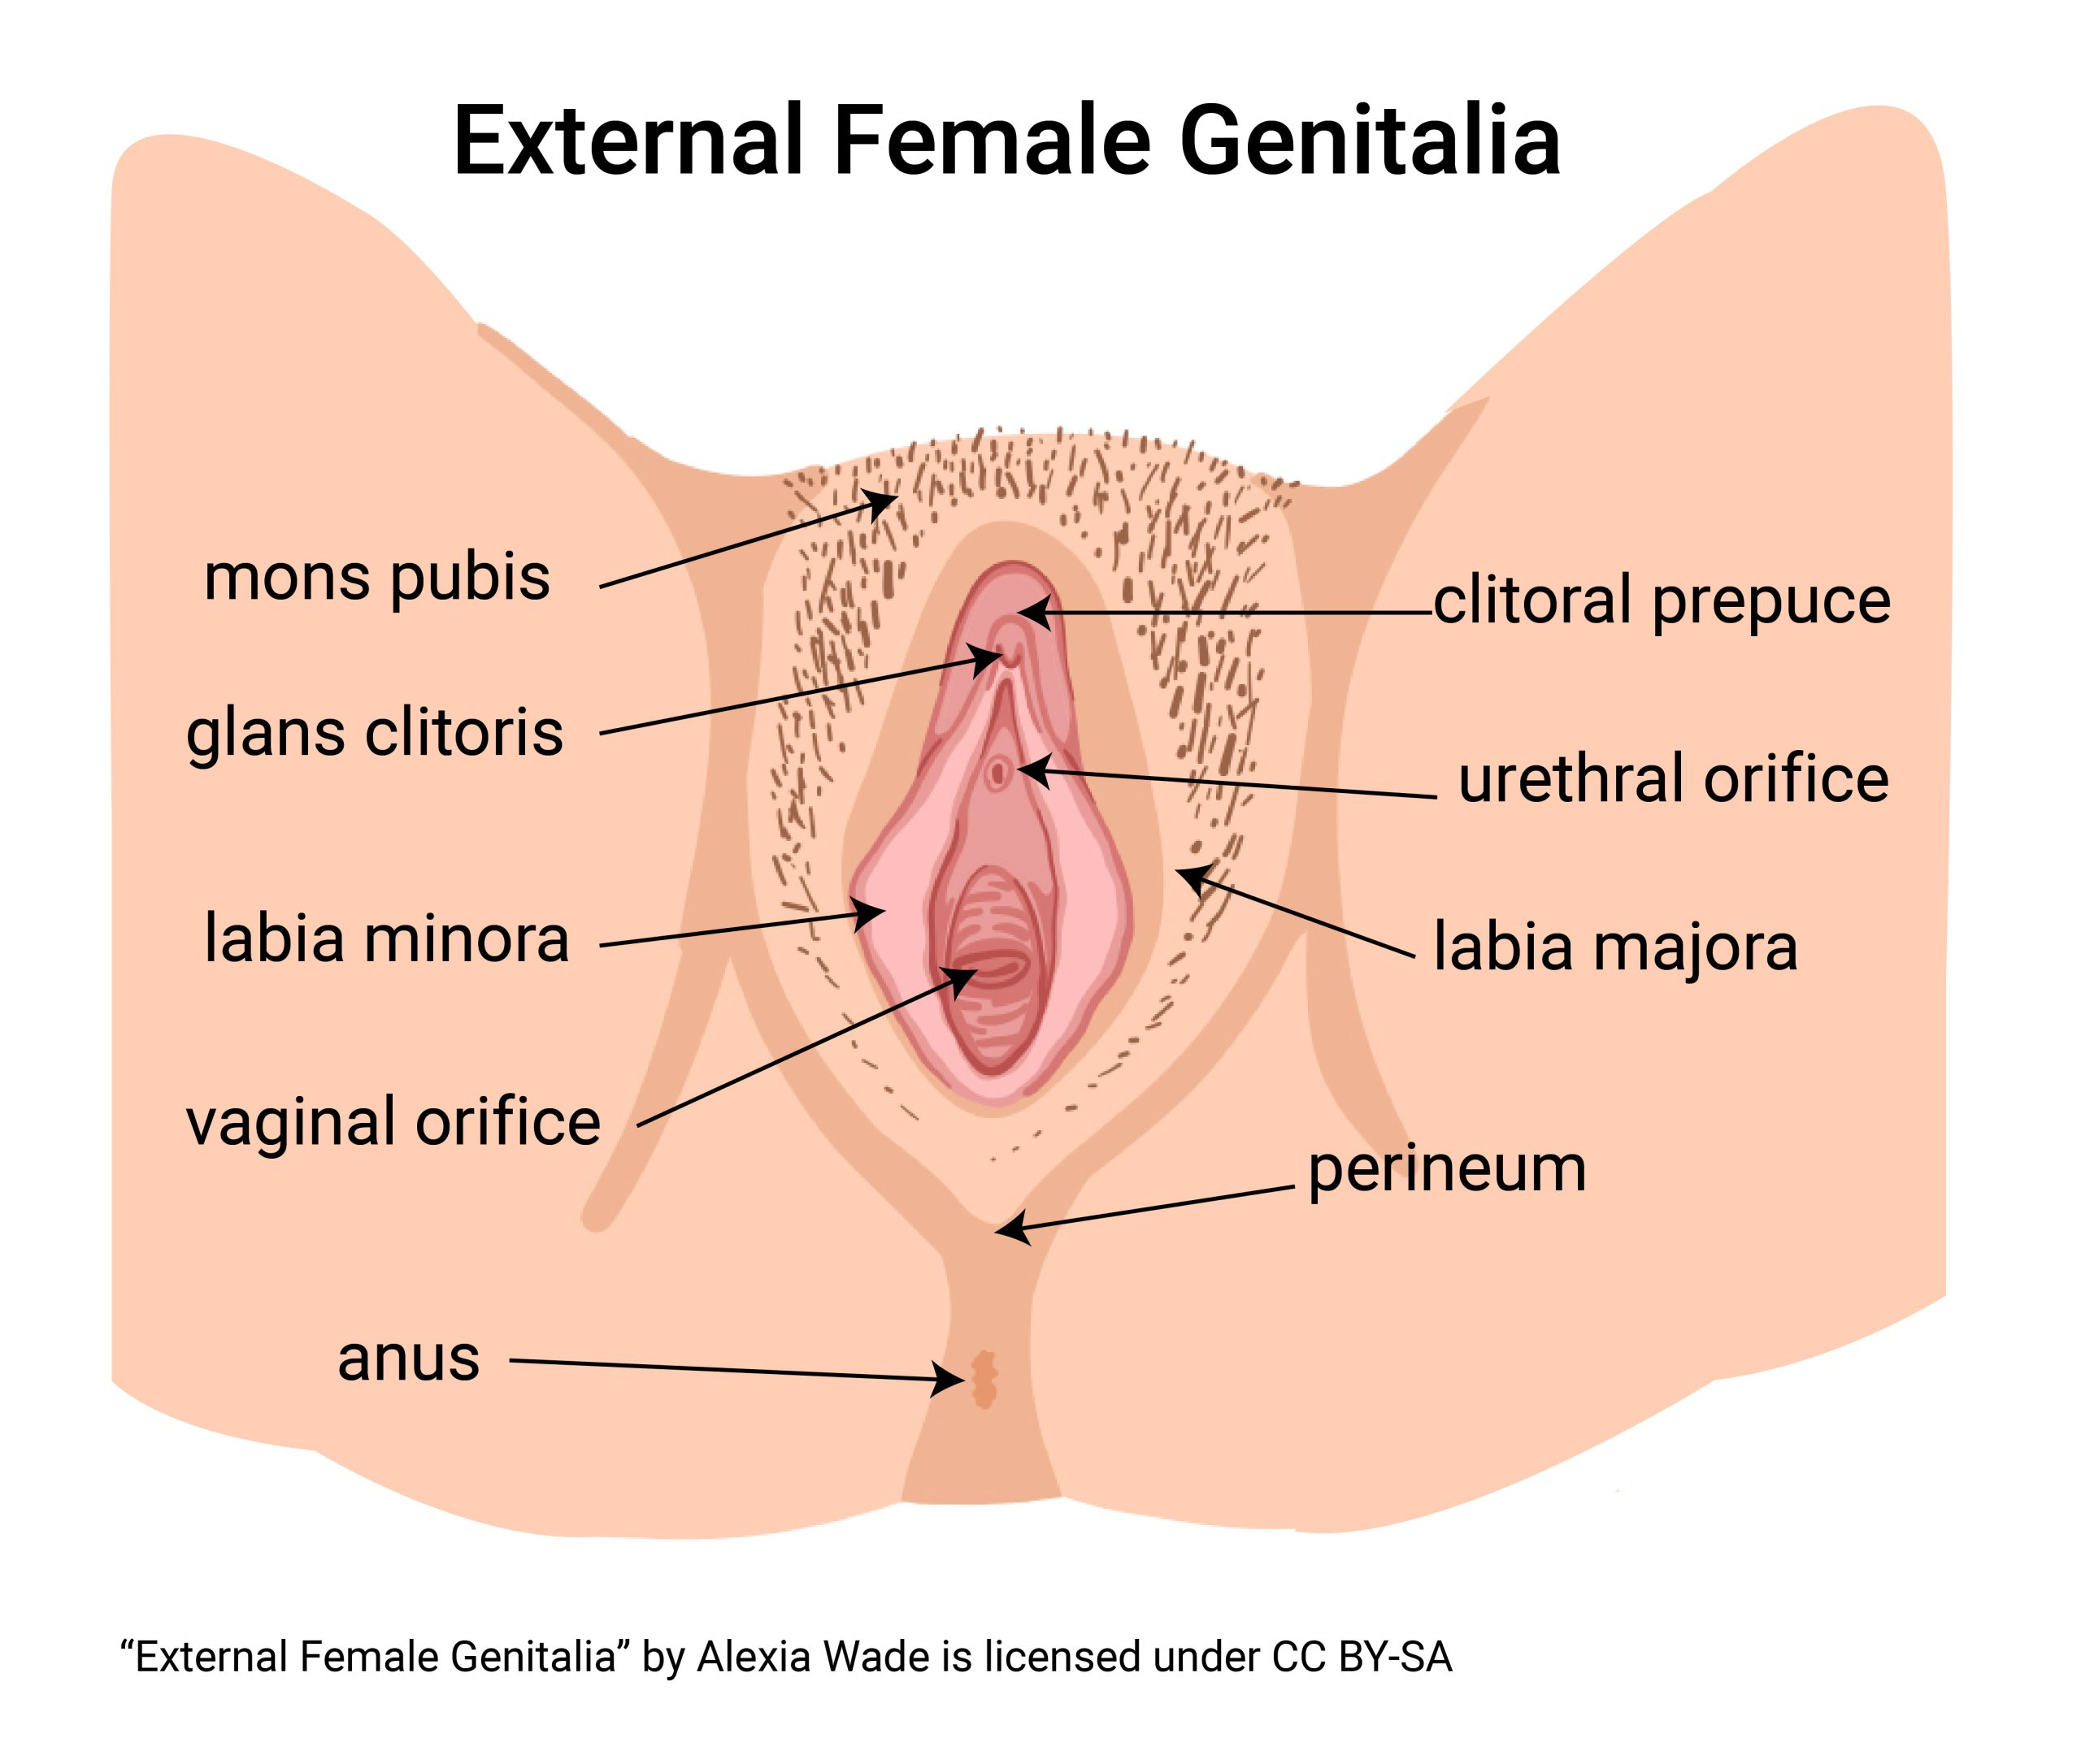
Inspect and palpate: External genitalia
Inspect mons pubis
Inspect labia majora and perineum
Inspect labia minora, clitoris, urethral meatus, and vaginal opening
Inspect perianal area
Notes:
Inspect mons pubis: Pubic hair is distributed in an inverted triangular pattern, and there are no signs of infestation. (Pubic lice, “crabs”)
Inspect for piercings and signs of infection from the site.
Labia majora/perineum: The labia majora are equal in size and free of lesions, swelling, and excoriation. A healed tear or episiotomy scar may be visible on the perineum if the client has given birth. The perineum should be smooth.
Abnormal: Lesions may be from an infectious disease, such as herpes or syphilis. Excoriation and swelling may be from scratching or self-treatment of lesions.
Labia minora, clitoris, urethral meatus, vaginal opening: The labia minora appear symmetric, dark pink, and moist. The clitoris is a small mound of erectile tissue, sensitive to touch. The normal size of the clitoris varies. The urethral meatus is small and slitlike. The vaginal opening is positioned below the urethral meatus. Its size depends on sexual activity and/or vaginal delivery. A hymen may cover the vaginal opening partially or completely.
Any lesions, swelling, bulging, or discharge should be investigated further.
Note any drainage from the urethra. Needs to be cultured. Possibly chlamydia or gonorrhea.
Inspect perianal area: Should be hairless, moist, and tightly closed. Skin is darker and more coarse than surrounding skin.
Look for lumps, ulcers, lesions, rashes. Could be: STI, malignancy, hemorrhoids, abscess.
Thickening of the epithelium suggests anal trauma or repeated anal intercourse.

Slide 9
Human Papilloma Virus (HPV)
Most common sexually transmitted infection
Most do not even know they have the virus; does not cause any symptoms, in 90% of the cases the immune system can fight it off
HPV vaccine recommended for girls aged 11-12 but can get it as early as age 9
Recommended for everyone up to age 26. May be given up to 45 if not previously vaccinated
Is recommended before sexually active; three separate injections over 6 months; routine Pap tests are still recommended
Causes most cervical, anal, vaginal, penile, and oropharyngeal cancers
Notes:
CDC.org
HPV is easily spread from sexual skin to skin contact with someone who has it. You can get it when your vulva, vagina, cervix, penis or anus touches someone else’s genitals or mouth and throat usually during sex.
In most cases (9 out of 10), HPV goes away on its own within two years without health problems. But when HPV does not go away, it can cause health problems like genital warts and cancer. (cervical, vulva, vagina, penis, anus, oropharyngeal)
Genital warts usually appear as a small bump or group of bumps in the genital area. They can be small or large, raised or flat, or shaped like a cauliflower.
People don’t even know they have the virus until they develop health problems from it.
HPV is so common that almost every sexually active person will get HPV at some point if they are no vaccinated.
HPV infection has been identified as a definite human carcinogen for six types of cancer: cervix, penis, vulva, vagina, anus, and oropharynx (including the base of the tongue and tonsils).

Slide 10
Evidence-based health promotion and disease prevention: Cervical Cancer
Risk Factors
Education
HPV infection
Smoking
Immunosuppression
Chlamydia infection
Overweight
Family History
Avoid risky sexual practices
Consult your physician about HPV vaccination for boys and girls
Follow routine guidelines for Pap smears
Eat nutritious food
Have routine care for illnesses that weaken your immune system
Notes:
Cervical cancer used to be the leading cause of cancer death for females in the United States. However, in the past 40 years, the number of cervical cancer cases and deaths has decreased significantly. This decline is the result of (1) many individuals getting regular Pap tests, which can find cervical precancer before it turns into cancer, and (2) likely HPV vaccinations.
Originates in the uterine cervix. 8 out of 10 originate in the surface lining cells (squamous cell carcinomas). Slow developing cancer, preceded by a precancerous stage of dysplasia which can be diagnosed easily with a Pap smear. Dysplasia is 100% treatable.
Cases have dramatically decreased due to Pap smear screening.
Virtually all cases of cervical cancer are caused by HPV, and two types (16 & 18) are responsible for 70% of all cases. HPV is acquired through intercourse with an infected partner.
Screening:
Screening for cervical cancer in females aged 21 to 65 years with cytology (Pap smear) every 3 to 5 years.
Screening with cytology alone every 3 years and screening with HPV testing or a combination of cytology and HPV testing every 5 years for females aged 30 to 65 years.
Females older than 65 years who have not had adequate screening (three consecutive negative tests or two negative tests within 10 years prior to stopping screening) and are otherwise at high risk.

Slide 11
Evidence-based health promotion and disease prevention: Colorectal cancer
Third most common cancer diagnosis in the U.S.
Lifetime risk
  1 in 23 males
  1 in 25 females
Originates in the large intestine or rectum
Most begin as a polyp on the inner lining that becomes cancerous
Readily treatable if found early
Screening begins at age 45; continues to age 75
  Fecal occult blood testing, sigmoidoscopy, or colonoscopy
Notes:
Education:
Call your health care provider if you notice any of the following symptoms: black, tarry stools, blood during a bowel movement, change in bowel habits, or unexplained weight loss.
Follow preventative screening guidelines.
Avoid a diet high in red and processed meat, high in fat, or low in fiber.
Avoid smoking cigarettes and keep alcohol intake to a minimum.

Slide 12
Colorectal cancer
Risk factors: Non-modifiable
  Age >50
  African American or eastern European descent
  Inflammatory bowel disease
  Personal or family history
  Type 2 diabetes
Risk factors: Modifiable
  Obesity
  Physical inactivity
  Smoking
  Alcohol use
  Poor diet high in red or processed meat
  HPV infection
Notes:
Unclear risk factors:
Night shift work
Previous treatment for prostate cancer (risk for colorectal cancer) or testicular cancer (risk for rectal cancer)
Client education:
Report any change in bowel habits or blood in stool
Report any unexplained weight loss
Follow screening guidelines
Avoid a diet high in red meat, fat, or low in fiber
Avoid smoking
Keep alcohol at a minimum

Slide 13
Evidence-based health promotion and disease prevention: Hemorrhoids
Swollen, inflamed veins in the lower rectum and anus
Symptoms
  Painless bleeding during bowel movements
  Itching
  Irritation
  Pain/discomfort
  Swelling in the anal region/lumps near the anus
  Sensitivity in the anus region
Notes:
Hemorrhoids: can be found in male and females. Also called piles.
They can be internal or external.
Hemorrhoids are more prevalent in persons between 45 and 65 years of age; they are associated with conditions that increase pressure in the hemorrhoidal venous plexus. These include straining at bowel movements, prolonged sitting on the toilet, chronic diarrhea or constipation, obesity, pregnancy, anal intercourse, eating a low-fiber diet, and regular heavy lifting.
Client teaching: high fiber diet, avoid straining, regular exercise, drink plenty of water (6-8 glasses per day), avoid sitting for prolonged periods, attempt to have a bowel movement as soon as the feeling occurs, avoid anal intercourse, use OTC creams or soothing pads, apply ice packs

Slide 14
Older adult considerations
Natural lubrication is decreased
Pubic hair decreases, thins, and grays
Incontinence may develop from muscle weakness or loss of urethral elasticity
Vaginal atrophy
  Thinning and drying of the vaginal walls
  Due to decrease of estrogen
  Increases risk of infection and trauma
  May make intercourse painful
Any postmenopausal vaginal bleeding needs follow up
Notes:
Natural lubrication is decreased: As women age, their estrogen production decreases causing atrophy of the vaginal mucosa. These women may experience dyspareunia and may need to use lubrication to increase comfort during intercourse. Women experiencing surgical menopause, symptoms of which occur more abruptly, may also benefit from lubrication.
Pubic hair decreases, thins, grays and sparse
Vaginal atrophy increases the risk for infection and trauma The older client is more susceptible to vaginal infections because of atrophy of the vaginal mucosa associated with aging. Women with vaginal atrophy have a greater chance of chronic vaginal infections and urinary function problems. It can also make sexual intercourse painful.

Slide 15
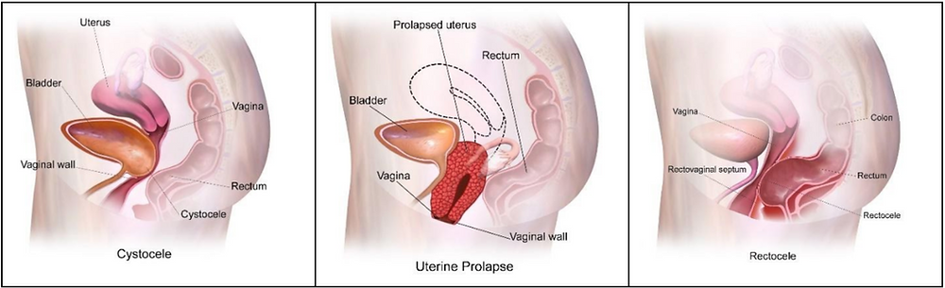
Older adult considerations: Pelvic floor prolapse
Notes:
Prolapsed uterus: Uterine prolapse is an abnormal findings and occurs when the uterus protrudes into the vagina. It is graded according to how fair it protrudes into the vagina. In first-degree prolapse, the cervix is seen at the vaginal opening, in second-degree prolapse the uterus bulges outside of the vaginal openings; in third degree prolapse, the uterus bulges completely out of the vagina.

Slide 16
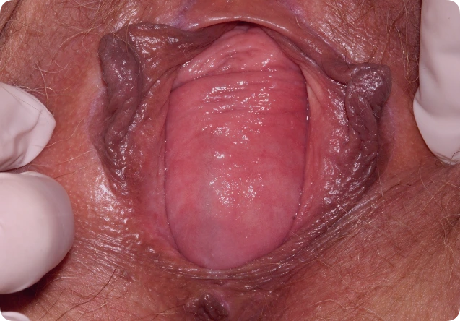
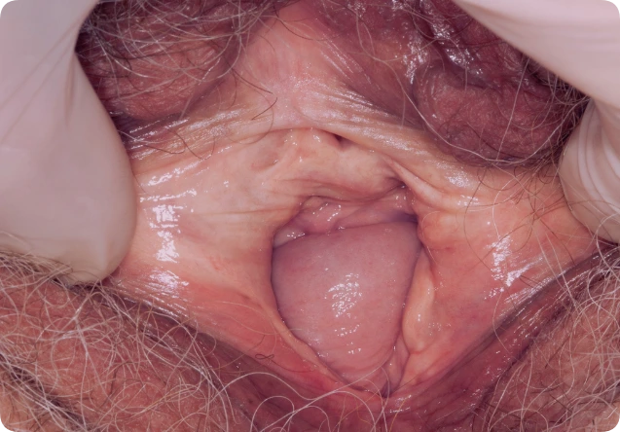
Cystocele & Rectocele
Notes:
Cystocele (bladder): a bulging in the anterior vaginal wall caused by weakening of the pelvic musculature. As a result, the bladder covered by vaginal mucosa prolapses into the vagina.
Rectocele (rectum) is a bulging in the posterior vaginal wall caused by weakening of the pelvic musculature. Part of the rectum covered by the vaginal mucosa protrudes into the vagina.
On left:
Vaginal wall prolapse. Close-up of a bulge in a 72 year old woman’s vaginal wall.
This is a cystocele, a condition where the vaginal wall weakens, in this case the anterior wall, and allows the bladder to fall into the vagina.
DR P. MARAZZI/SCIENCE PHOTO LIBRARY
On right:
Prolapse of the vaginal wall (rectocele) in an 82 year old female patient after a previous vaginal hysterectomy.
DR P. MARAZZI/SCIENCE PHOTO LIBRARY

Slide 17
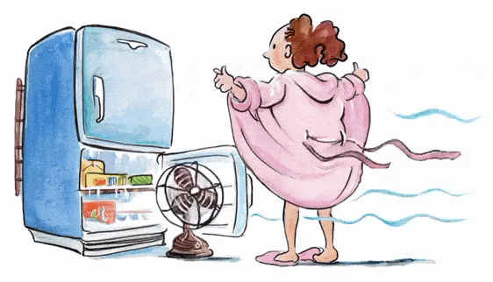
Questions?

